Slide 1
BLINN COLLEGE​
DUAL CREDIT PROGRAM​

Slide 2
What is Dual Credit?​
Dual Credit allows you to earn high school and college credit for the same class.​
A Dual Credit class is a college course.​
​
You will have a permanent college transcript.

Slide 3
Benefits​
Earn transferable college hours.
Dual credit tuition rates are lower than those for traditional college students.​
Gain college experience before enrolling full-time.
Access to all Blinn College facilities, student activities, athletic, music, and theater events with your Blinn ID​
Local area business discounts
Notes:
Core curriculum and degree plans can vary from college to college, so if you know your preferred degree/major or college, you should verify that the dual credit courses you choose are appropriate for that degree plan or school.​

Slide 4
Support Services​
Library​
Computer Labs​
Writing Center​
Learning Center​
Dual Credit Advising Services​
Academic Advising; Major Selection; ​
Transfer Information

Slide 5
Disability Services
Classroom accommodations offered vary according to the actual diagnosis, and appropriate supporting documentation must be received and approved by the Office of Disability Services (ODS)
APPROPRIATE DOCUMENTATION:
Student’s 504 Plan or Full Individual Evaluation (FIE) or Dyslexia Profile,
Documentation from student’s high school diagnostician and/or licensed psychologist or,
Documentation on letterhead from student’s medical doctor or other licensed person appropriate to make a diagnosis indicating the diagnosis or type of disability.
Documentation must show the current functioning of the student.
Complete the online Intake Packet (for new students) at https://www.blinn.edu/disability/forms.html

Slide 6
Disability Services
SEND DOCUMENTATION FOR BRENHAM, SCHULENBURG, SEALY, & WALLER CAMPUSES STUDENTS TO:
Brenham
Administration Bldg., Suite 104
Phone: 979-830-4157
Fax: 979-830-4410
Email: brenham.ods@blinn.edu
SEND DOCUMENTATION FOR BRYAN & RELLIS STUDENTS TO:
Bryan
Building D, Suite 160
Phone: 979-209-7251
Fax: 979-209-7558
Email: bryan.ods@blinn.edu
RELLIS
Schwartz Building, Suite 230
Phone: 979-209-8947
Fax: 979-475-1289
Email: rellis.ods@blinn.edu

Slide 7
How to Succeed!
Communication is important.​
Know when to seek help from your instructor.​
Email your instructor through your Blinn email account prior to any absences or if you have questions or concerns about the class.

Slide 8
Challenges​
College courses are demanding. Students are expected to perform at a collegiate level.
Requires strong self-discipline and self-direction.
If you earn below a 70, you will not receive a passing grade, which may impact your high school graduation.
Satisfactory Academic Progress may be affected.​
Classes follow the Blinn College calendar.

Slide 9
Typical Courses
HIST 1301 and 1302​
ENGL 1301 and 1302​
GOVT 2305​
ECON 2301​
Courses are determined by each school district. Additional courses are often available as college credit only.
Course crosswalk can be found on the Dual Credit webpage.

Slide 10
Grades​
Students are responsible for​:
following the course syllabus​.
keeping track of grades​.
keeping parents informed. ​
Check myBLINN at the end of the semester for your final letter grade​
Grades and bills are not mailed out.

Slide 11
FERPA
Family Educational Rights & Privacy Act [Federal Law]​
FERPA gives parents certain rights with respect to their children's education records. These rights transfer to the student when he or she reaches the age of 18 or attends a school beyond the high school level. Parents cannot access even a minor student’s college grades without documentation on file.​
Reach out to your counselor or the Dual Credit Office for more information.

Slide 12
Eligibility/Steps to Enroll​
Apply through Apply Texas (www.applytexas.org)
Complete the Dual Credit Approval Form
Must have at least a “B” average in completed school coursework.
Meet TSI requirements for eligibility
If taking courses on a Blinn campus, submit your bacterial meningitis shot record through your myBLINN account.

Slide 13
Electronic Dual Credit Approval Form
Student initiates the form.
Parent receives a link to create and activate an account.
Counselor receives the form.
Blinn receives the form and registers the student, if eligible.
Notes:
Did we want to put this in there?

Slide 14
TSIA Scores​
Old TSIA Scores
Math | 350 or higher
Reading | 351 or higher
Writing | Essay score of 5 OR Placement score of 350 and essay score of 4
TSIA 2.0
Math | CRC 950 or higher OR CRC 910-949 and Diagnostic Level 6
English Language Arts & Reading | CRC 945 or higher and Essay 5 or higher OR CRC 910-944 and Diagnostic Level 5-6 and Essay 5 or higher
Notes:
Students must demonstrate college readiness unless they are exempt from testing due to their SAT or ACT scores. ​
TSIA scores are valid for 5 years. Including scores from the old test.
Blinn College offers TSIA testing​
Students must apply to Blinn prior to testing, and then take the ​pre-assessment activity

Slide 15
Exemptions/Waivers​
Assessment​ | Math/Algebra​ | ELA/Reading Skills​ | Combined/ Composite​
ACT​1 | 19​ | 19​ | 23​
ACT2 | 22 | 40
SAT​ | 530​ | 480​ | ​
PSAT/NMSQT3​ | 510​ | 460​ | ​
Algebra I EOC3 | Minimum score of 4,000 on Algebra I EOC & passing grade in Algebra II
English II EOC3 |  | Minimum score of 4,000 on English II EOC
1 ACT administered prior to February 15, 2023; Students must meet both relevant subject and combined/composite score standards
2 ACT administered on or after February 15, 2023
3 The EOC & PSAT waivers only apply for dual credit classes.
Notes:
- EOC and PSAT scores waive a student into the course. They must successfully complete the course with a "C" or better to be considered TSI complete and continue with dual credit.
- If they do not make a "C" or better they will need to submit TSIA college ready scores to continue in dual credit.

Slide 16
myBLINN
myBLINN is the Blinn College online registration and information system​
View :
Blinn College transcript​
Pay fees​​
Degree Audit
Admissions Forms
eCampus
Bookstore Links

Slide 17
Notes:
What is myBLINN?​
myBLINN is the Blinn College online registration and information system​
You can...
-View Admissions Forms that include ID Picture Submission and Dual Credit Approval Form
- View your Blinn College transcript​
- Pay ​and view grades. Grades and bills are NOT mailed out.
- View Degree Works. You can see what courses are required for the degree plan, and track your progress.

Slide 18
Degree Audit

Slide 19
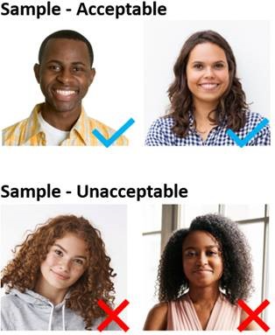
ID Request Form
Located in the Dual Credit section of Admissions Forms on myBLINN
Student's responsibility
Notes:
Photo Requirements
Color photo in .jpg format
Front view of your head and shoulders only (No side profiles, head turns or tilts)
Solid white smooth background (No other people or backgrounds in photo)
Sufficient lighting with no shadows
Do not retouch, enhance or soften photo
No hats, sunglasses or other items that obscure your face Files over 25 MB will not be accepted

Slide 20
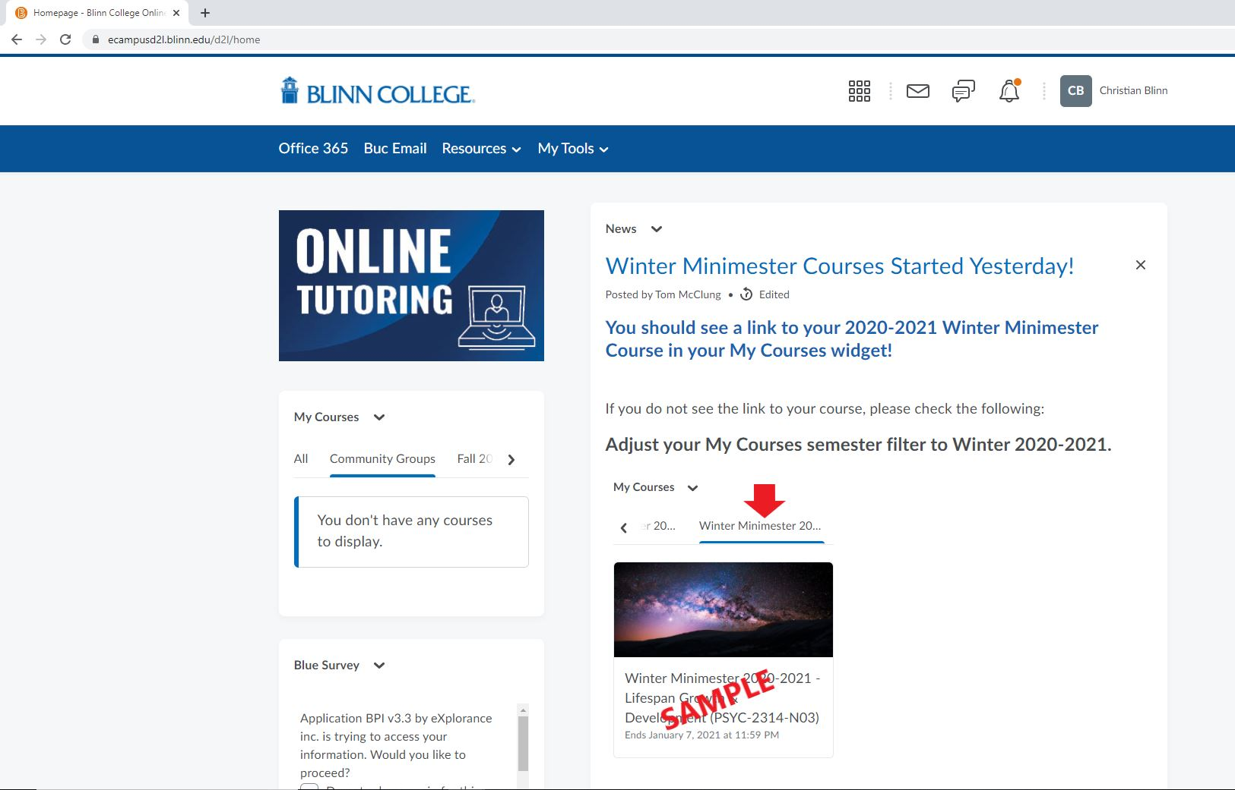
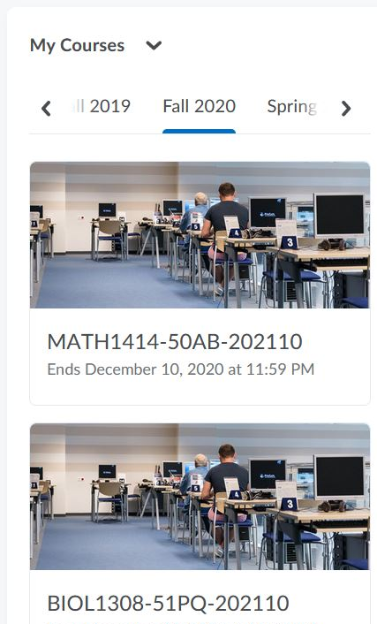
eCampus
Notes:
What is eCampus?​
eCampus is the learning management system used by Blinn College. Students log into eCampus from their computers and access the information provided by the instructor.

Slide 21
STUDENTS
AUTOMATICALLY
receive all their books and access to electronic materials on or before the first day of class
MATERIALS ARE INCLUDED
as a single course charge to the student account
SIGNIFICANT STRESS REDUCTION & COST SAVINGS
for students versus the traditional model
Notes:
First Day Complete helps to remove barriers for students.
Review slide and callout pillars
Access
Convenience
Affordability

Slide 22
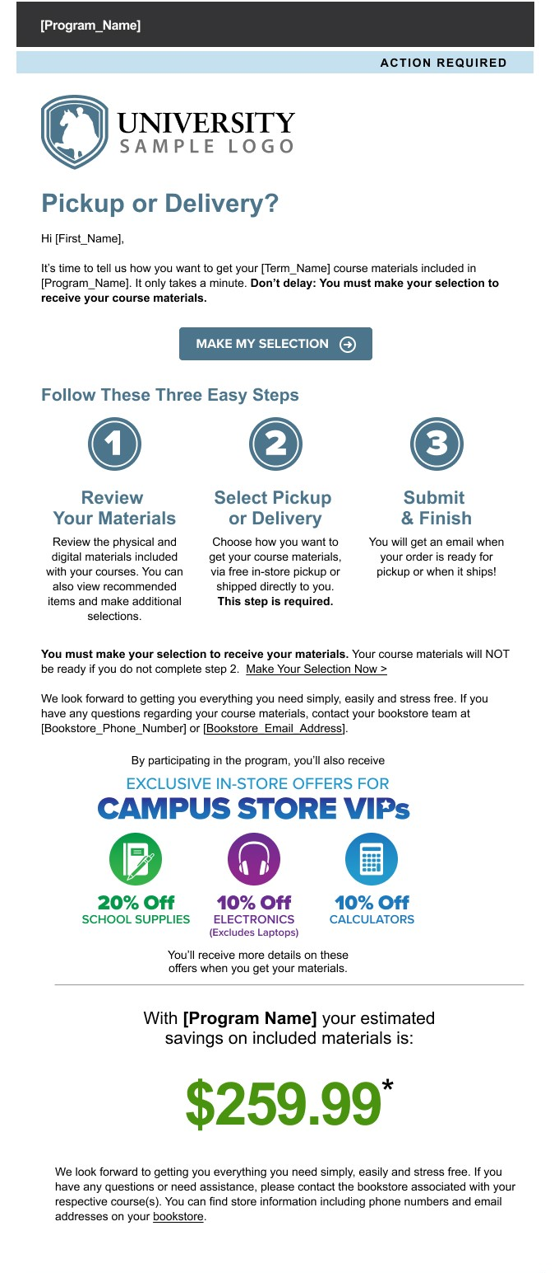
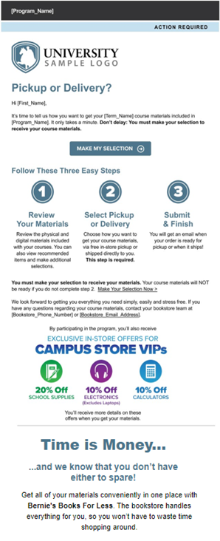
PERSONALIZED STUDENT COMMUNICATIONS​
Student emails provide the student clear updates and include personalized messaging on the time and savings the program will provide them.

Slide 23
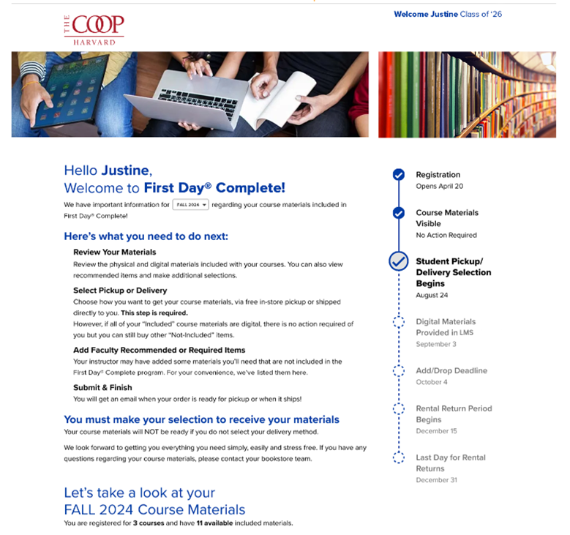
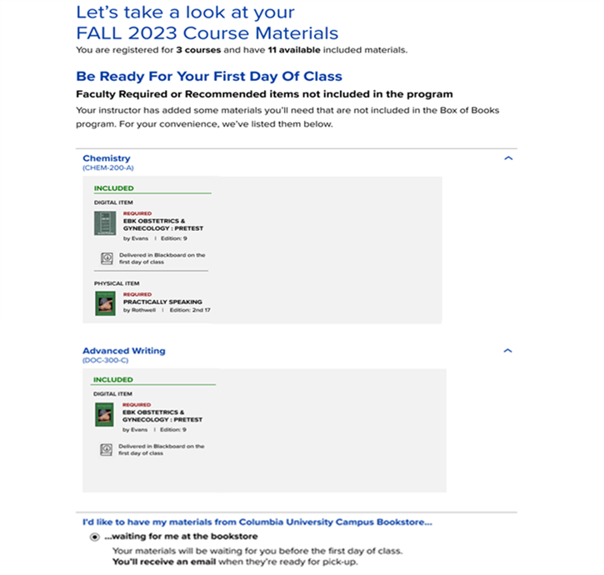
PERSONALIZED STUDENT EXPERIENCE​
STEP 1 |
REGISTER FOR CLASS
VERIFY MATERIALS
BucBooks
STEP 2 |
STEP 3 |
SELECT FULFILLMENT METHODS
STEP 4 |
RECEIVE MATERIALS
END OF TERM:
RETURN MATERIALS
STEP 5 |
First Day Complete Student Experience
Notes:
Review slide

Slide 24
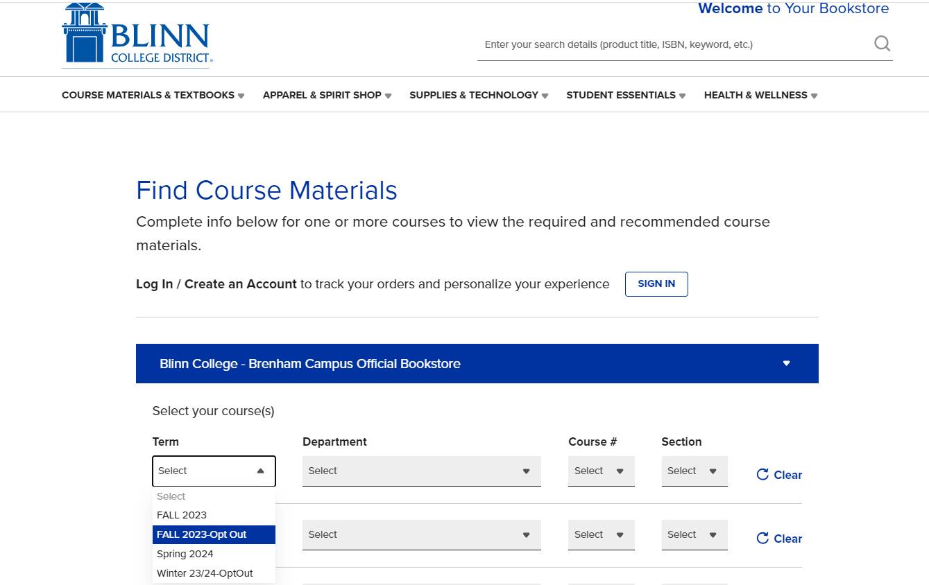
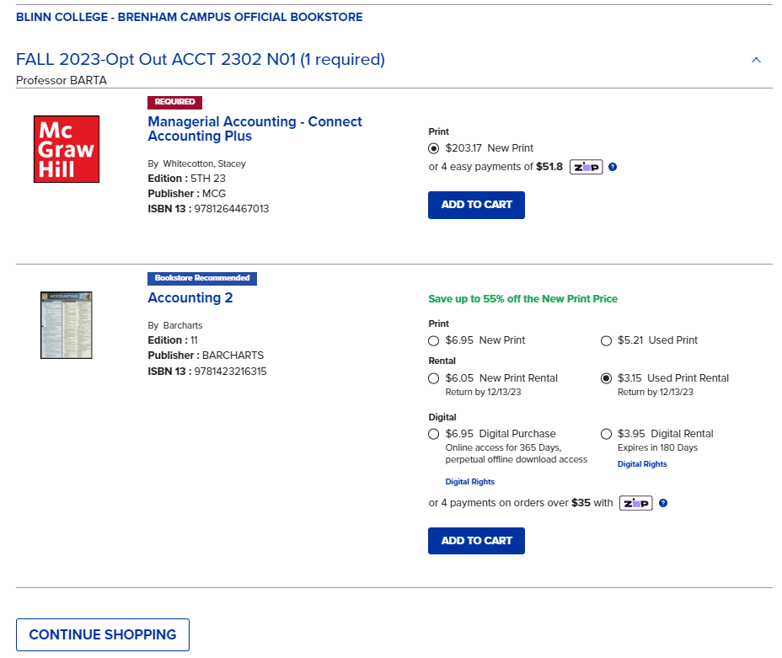
OPT-OUT STUDENT EXPERIENCE
Opt-out students purchase access directly through the Blinn College Bookstore website.
https://blinncol.bncollege.com
Students purchase through the “Opt-Out” Term

Slide 25
Due Dates & Deadlines​
Dual Credit Due Dates​
Changes in classes and schedule due​ | February​ 2024
Applications and approval forms due​ | May 20th ​
All test scores due​ | June 30th
Class rosters due​ | August 1st
Payment due for Summer I | May 20th
Payment due for Summer II | June 24th
Payment due for Fall 2024 | August 5, 2024

Slide 26
Contacts
Mrs. Shannon Williford​
Director, Dual Credit Programs​
979-209-8218 shannon.williford@blinn.edu ​
Mrs. Jordan Scott
Coordinator, Dual Credit Programs
979-209-7522 jordan.stautzenberger@blinn.edu
Mrs. Shannon Whigham
Advisor, Dual Credit Programs
979-830-4807 shannon.whigham@blinn.edu
Website: www.blinn.edu/dual-credit
Email address: dualcredit@blinn.edu

